Slide 1
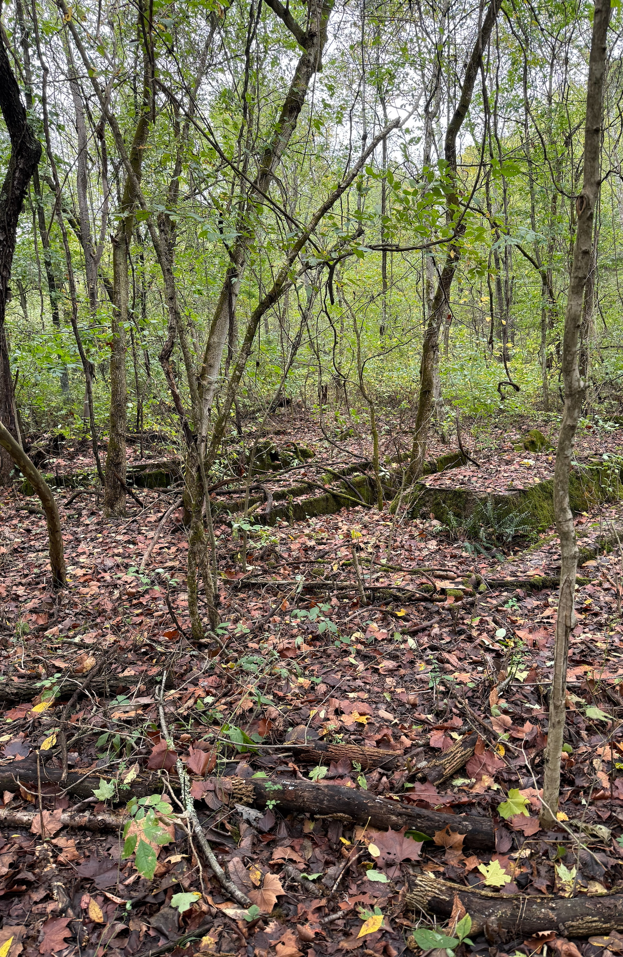
SEO Revitalization: Our take
HC 2905: Foothills Justice
Colton Ashcraft
Isaac DeBord

Slide 2
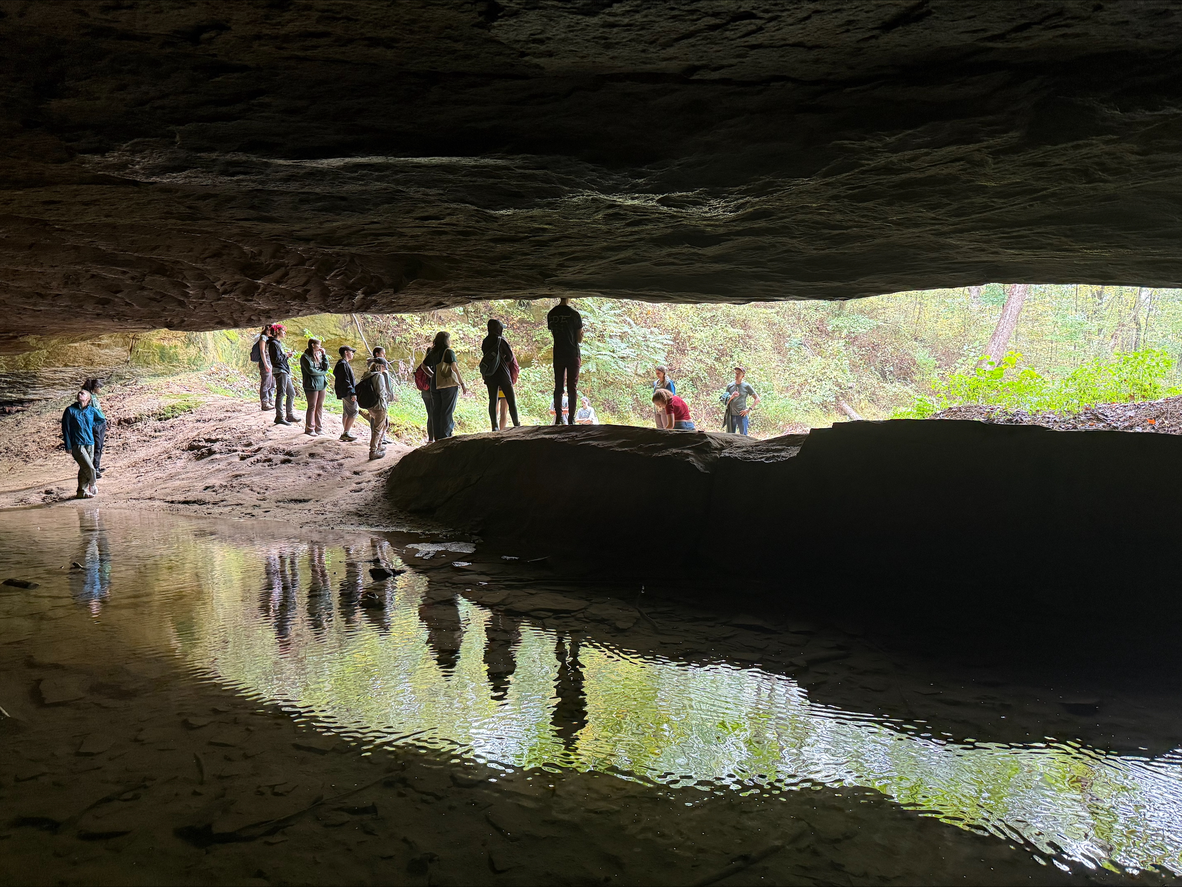
Robinson’s Cave
Why it matters:
Key spot in labor movements.
Preserving history could boost tourism and learning.
The fact that the fire is still burning is interesting

Slide 3
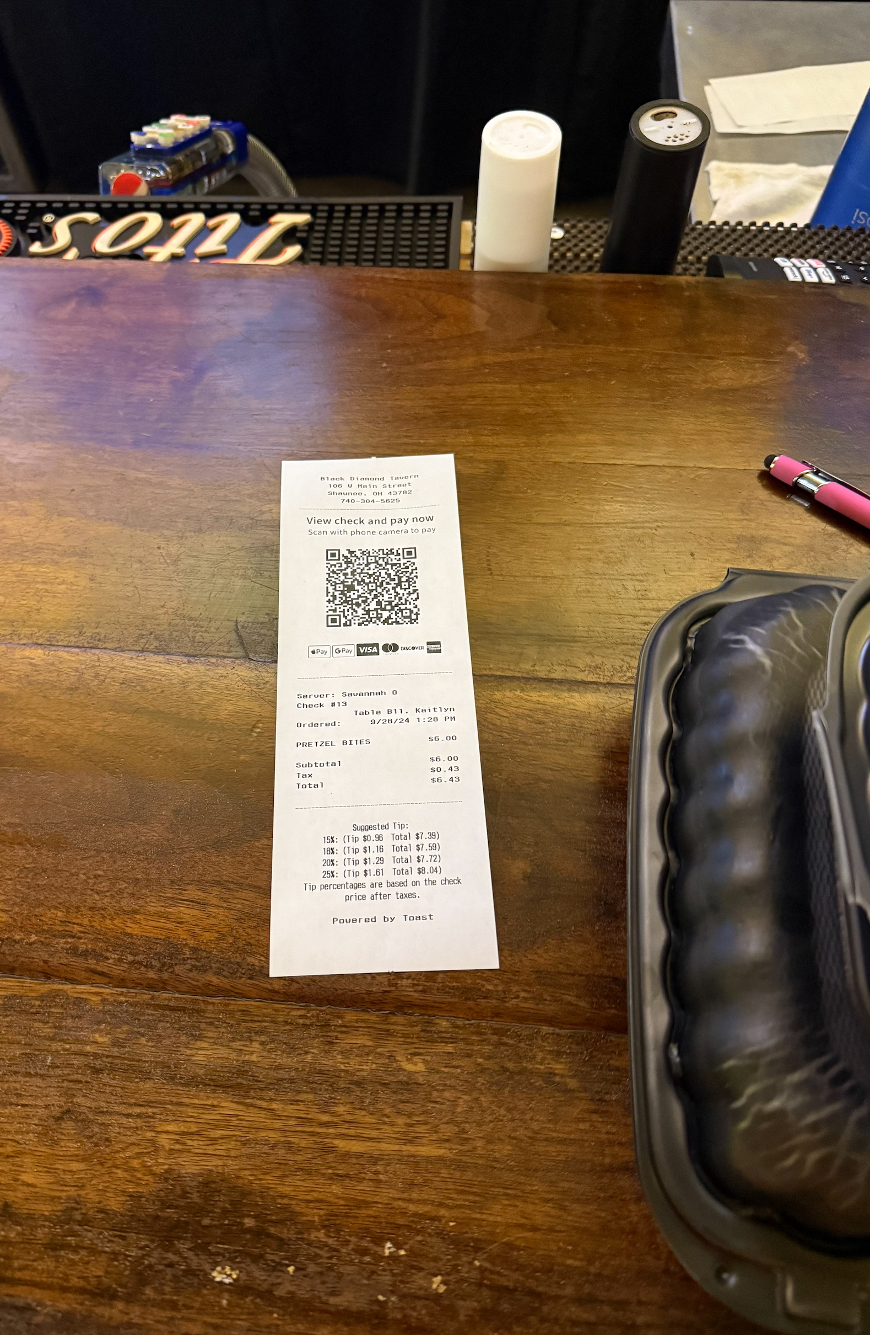
Trotter’s Bar & Grille
What we liked:
Shows how local businesses can bring people together.
Growing tech (receipt)
We were excited about a place as nice as this as well as the renovated theater next to it.

Slide 4
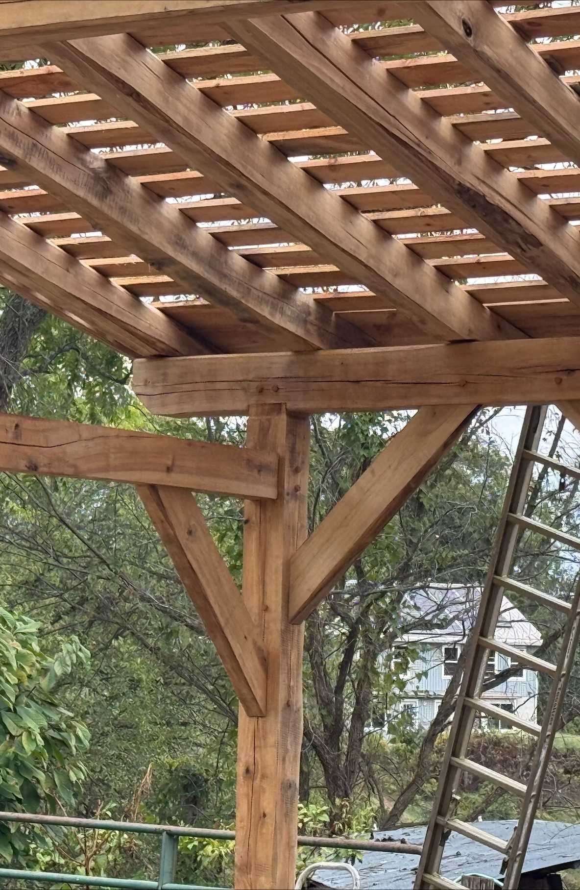
Future of SEO
Our thoughts:
Fixing what industry left behind (like True Pigments project).
Combining eco-restoration with new economic opportunities.
What can be enhanced:
More funding for solid ground.
More volunteering for cleanup.

Slide 5
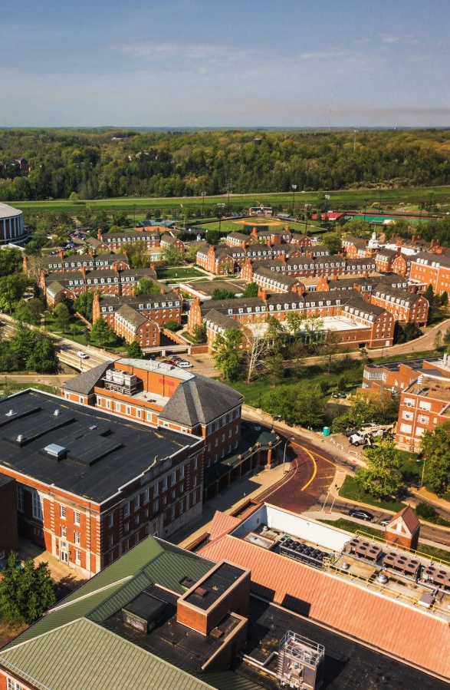
How OU Students Can Help
Where we fit in:
Get involved in local projects (volunteering, etc.).
Help promote cultural and environmental awareness through new clubs and growing other existing groups
Join on campus environmental groups.

Slide 6
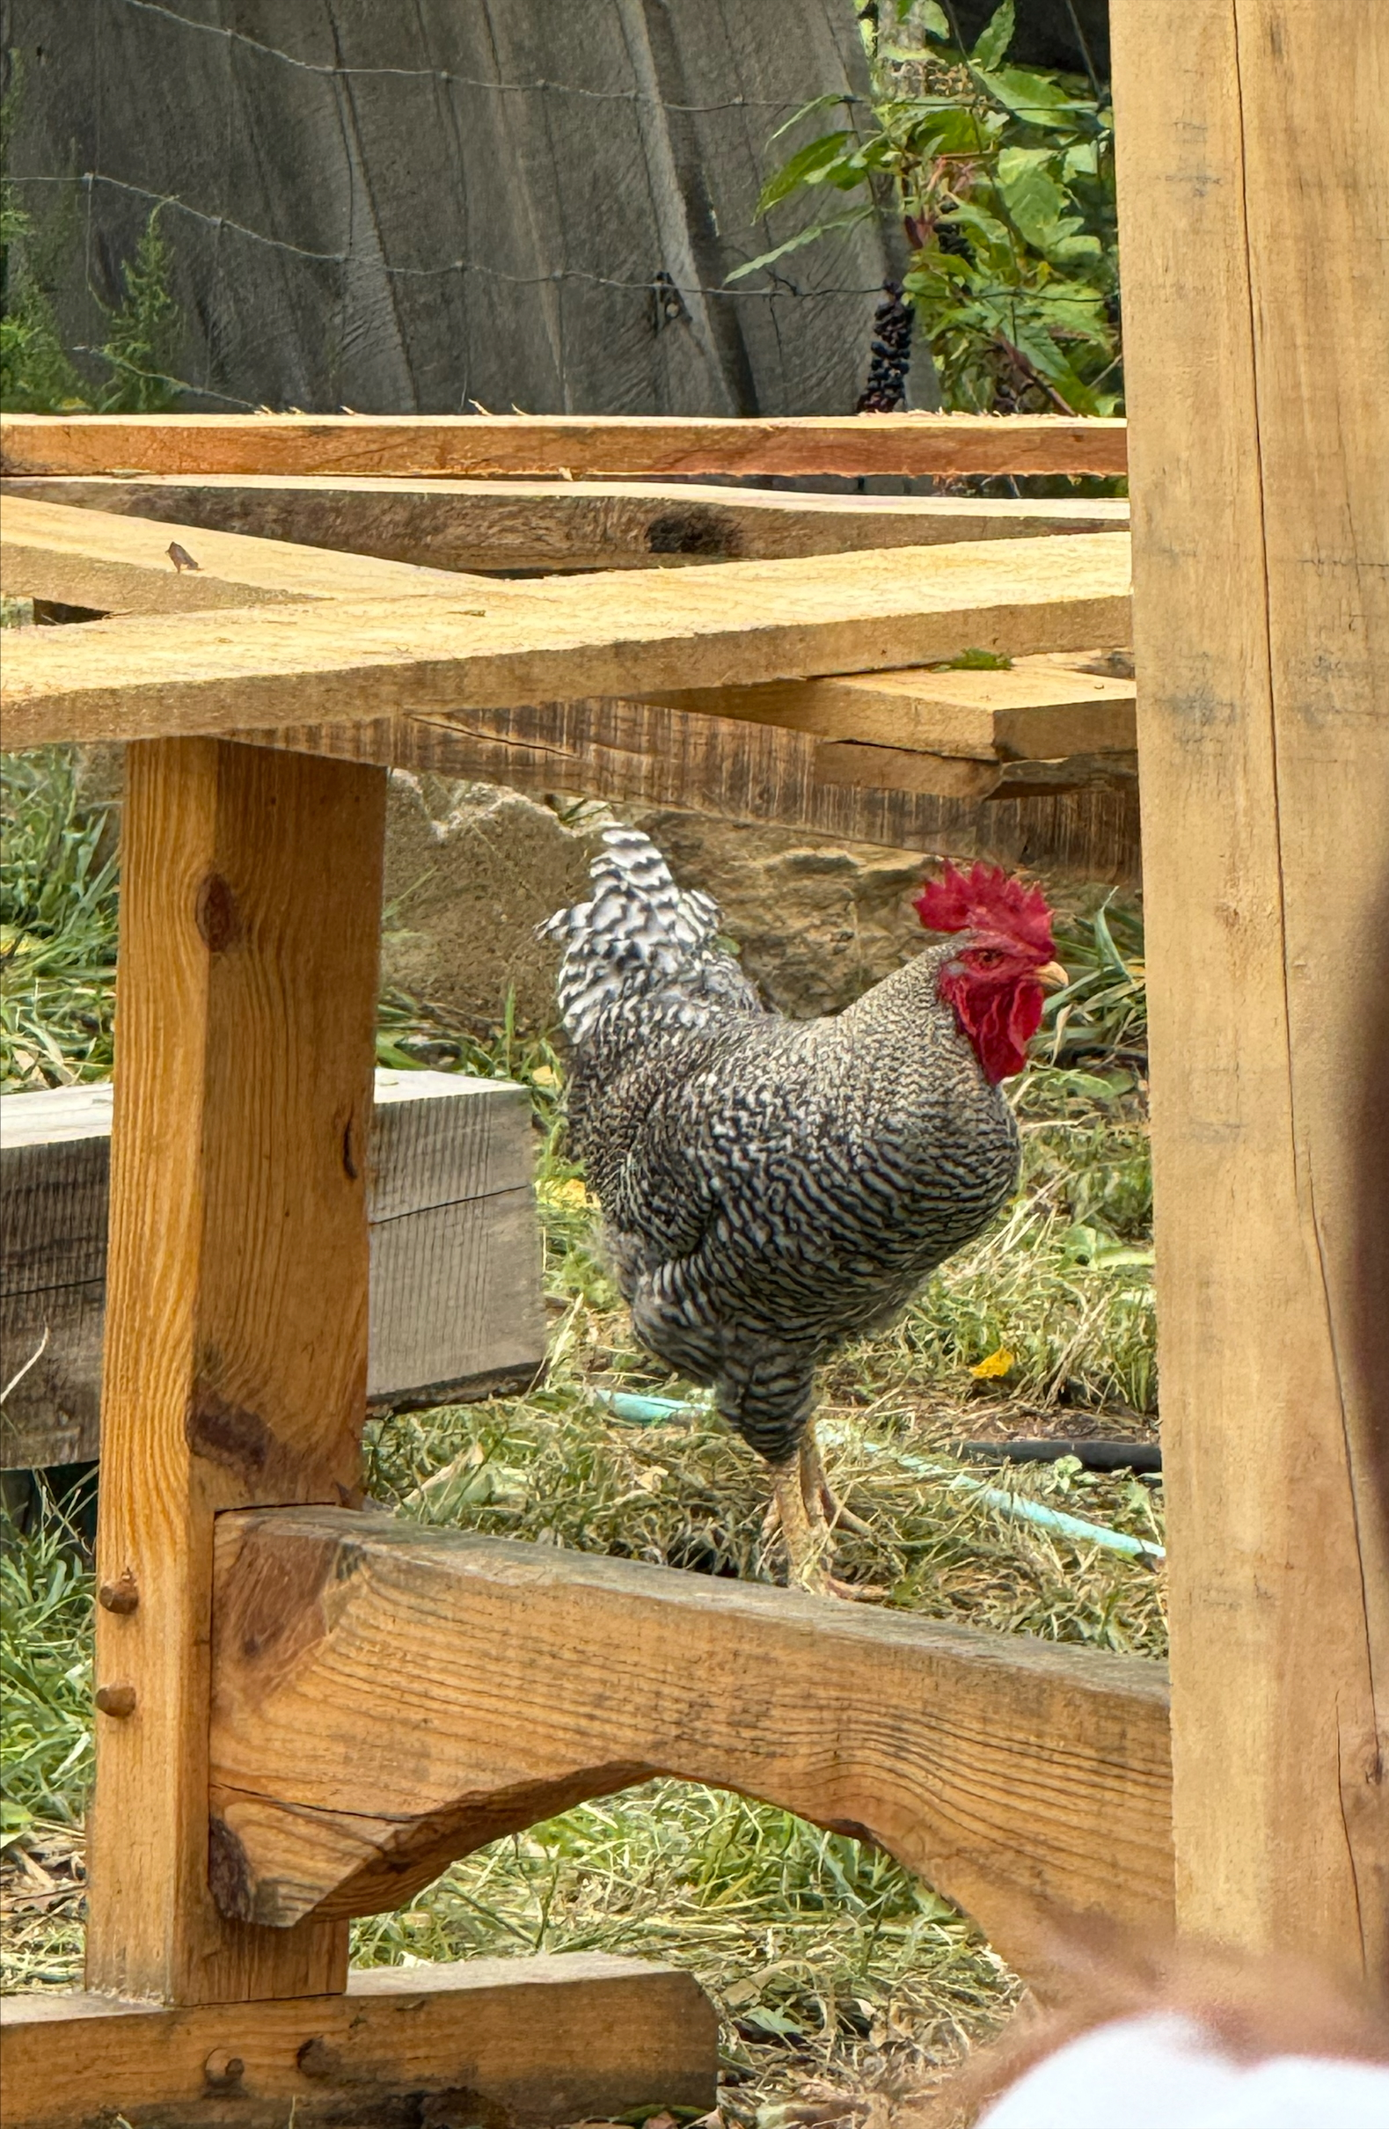
Final Thoughts/Questions we had
What’s next?
How can SEO continue to grow without hurting the environment?
How can we lower our footprint?

